Slide 1
Sub Kick Generator
EP-353 Final Project, by Aaron Wolff

Slide 2
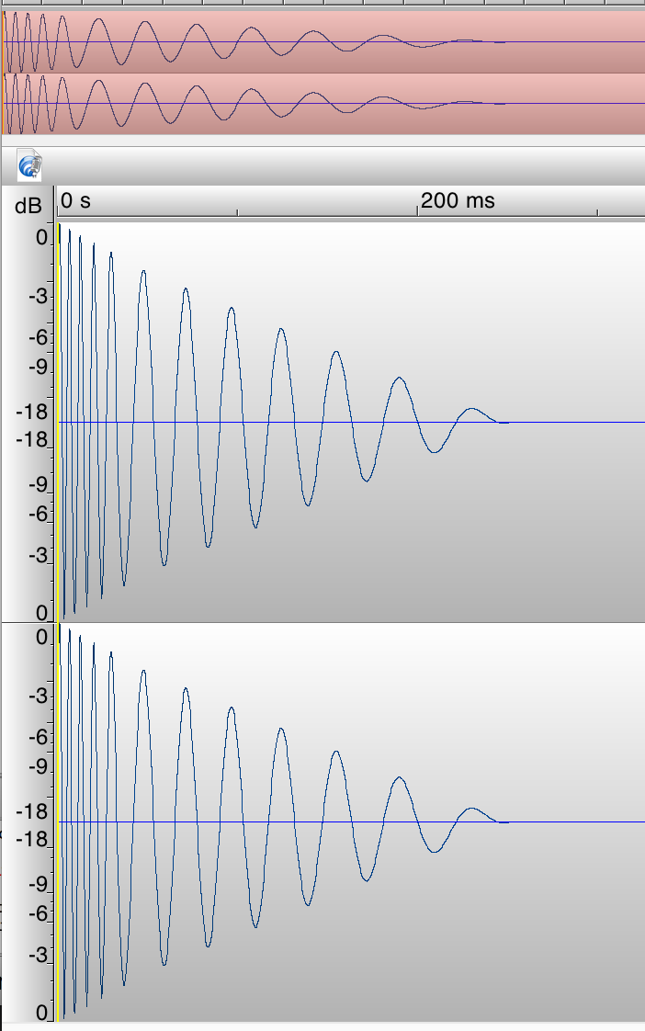
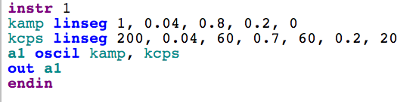
Making kicks with numbers is very reliable

Slide 3
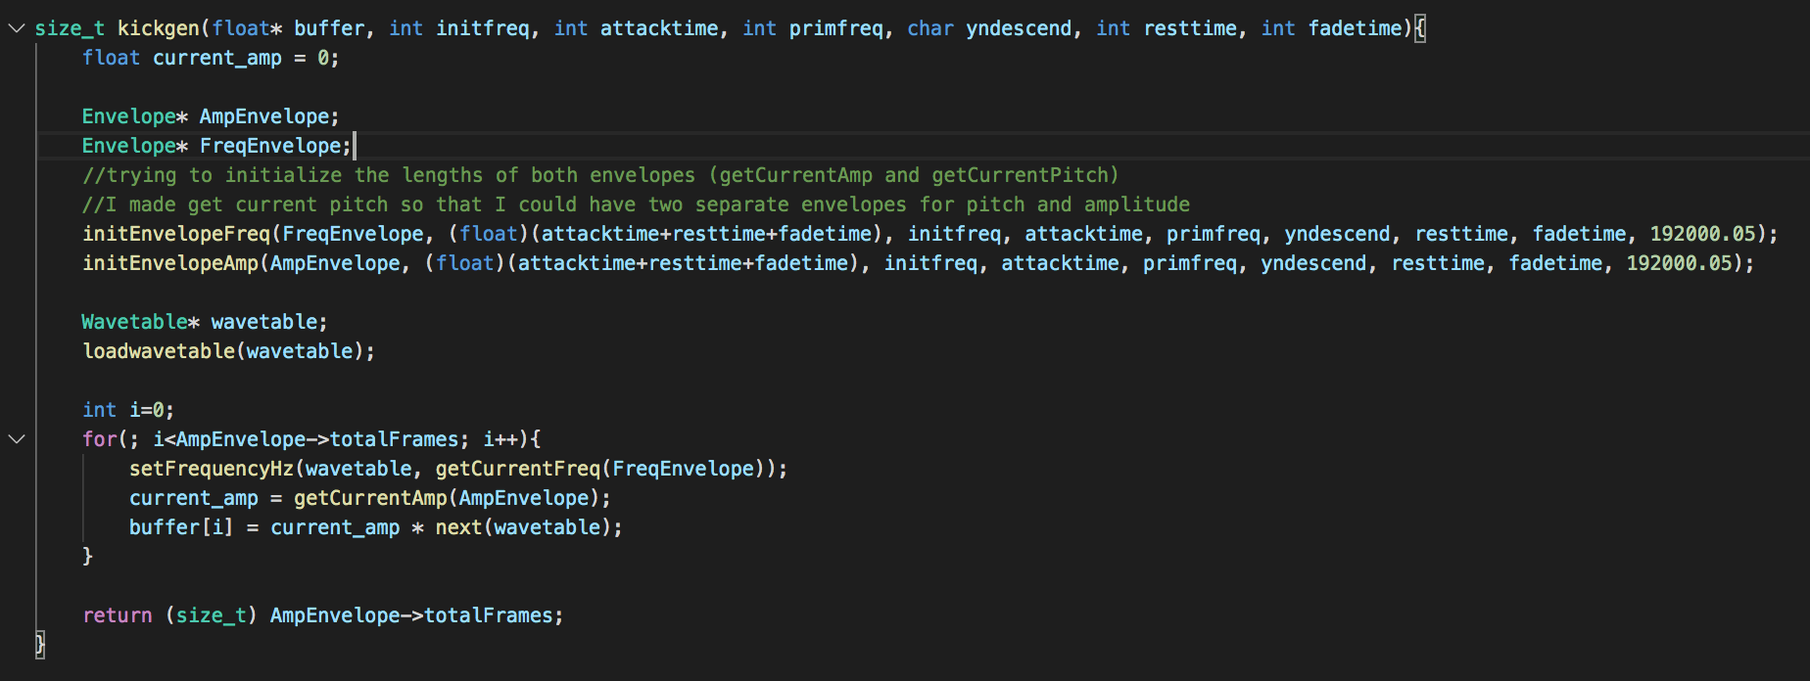

Slide 4
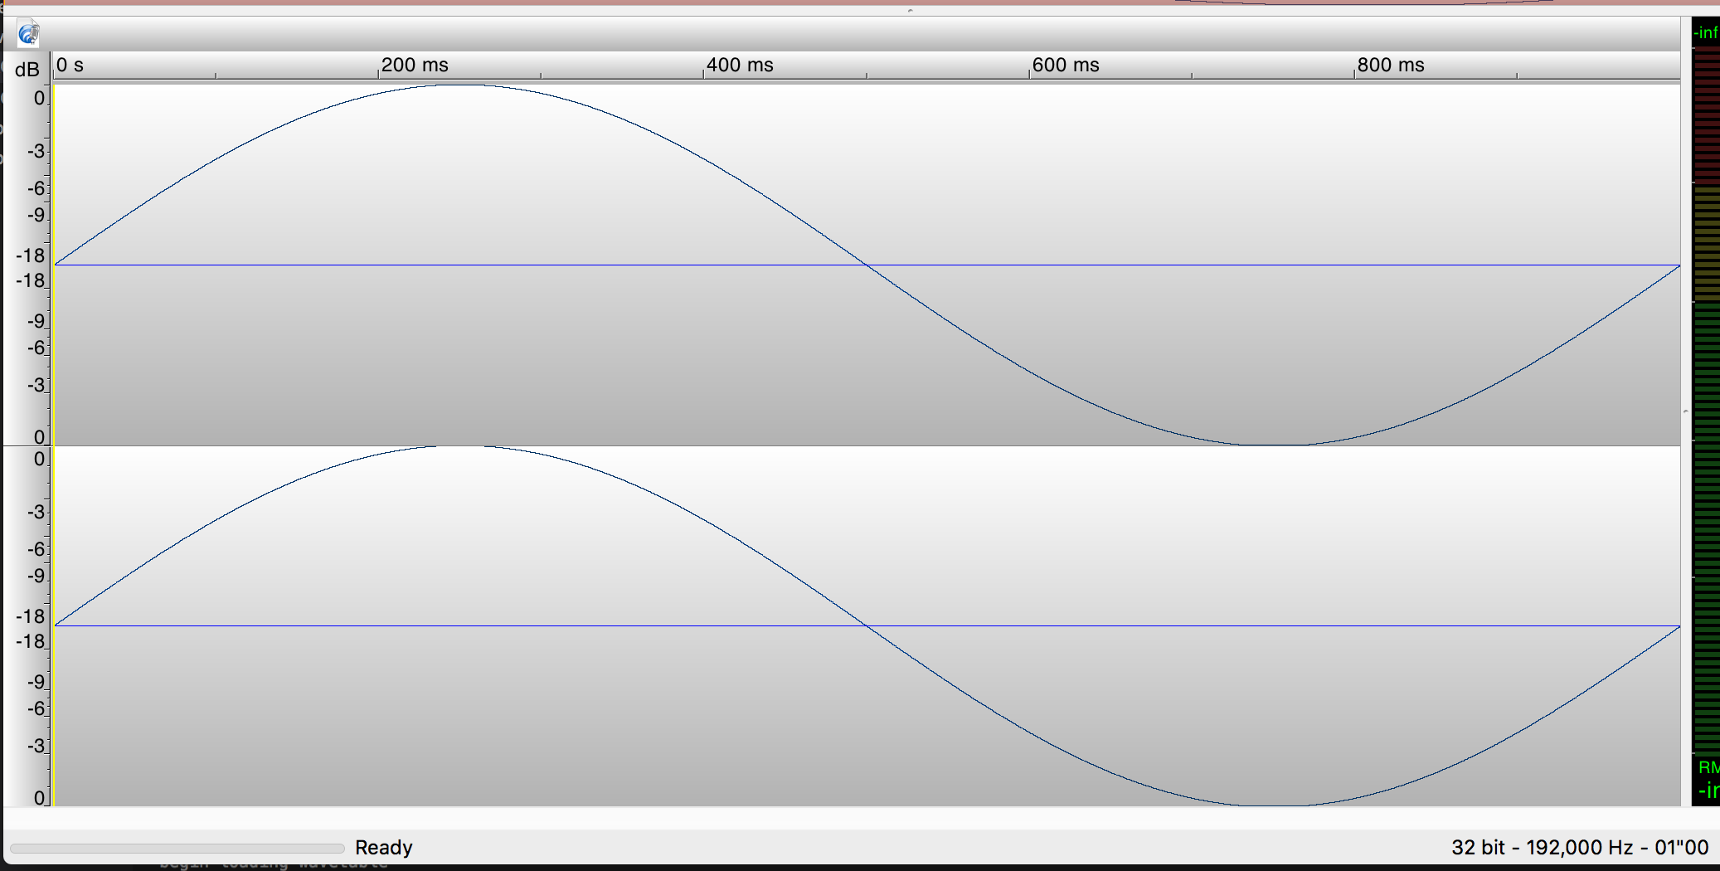
Using a Wavetable

Slide 5
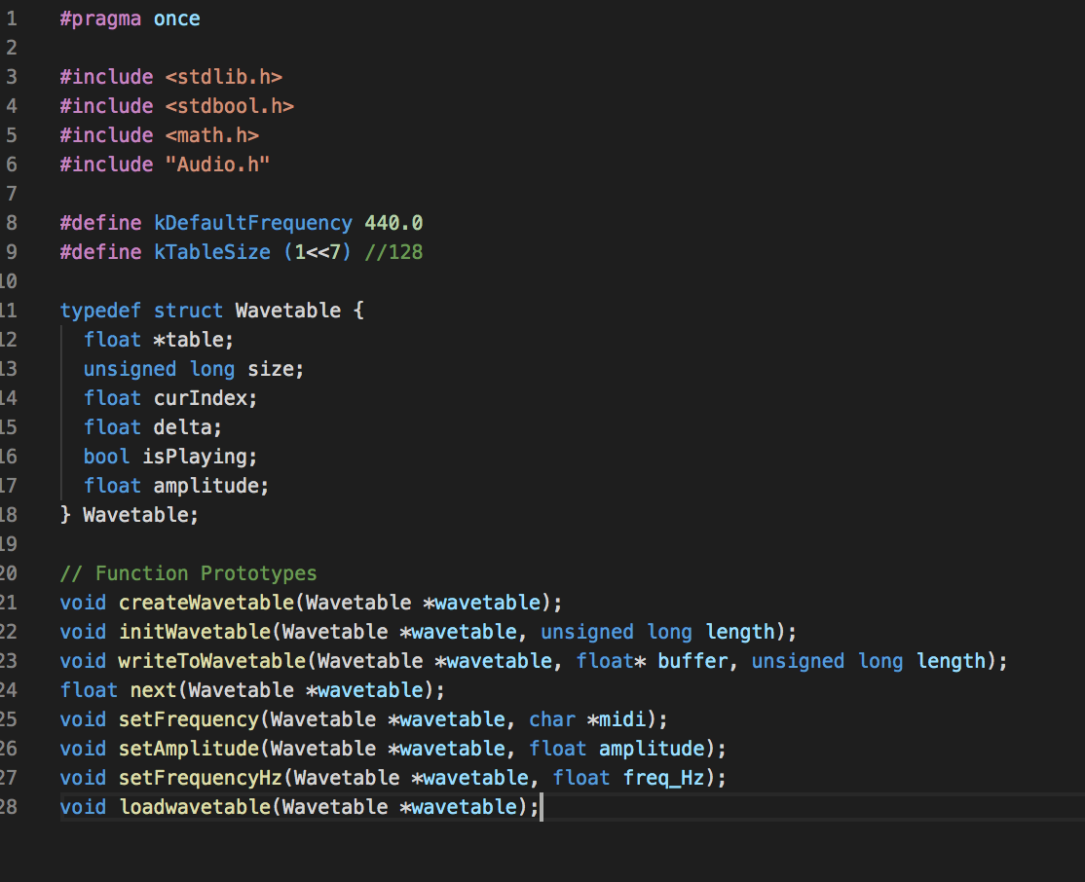
Wavetable.h and Wavetable.c
Thank you Akito

Slide 6
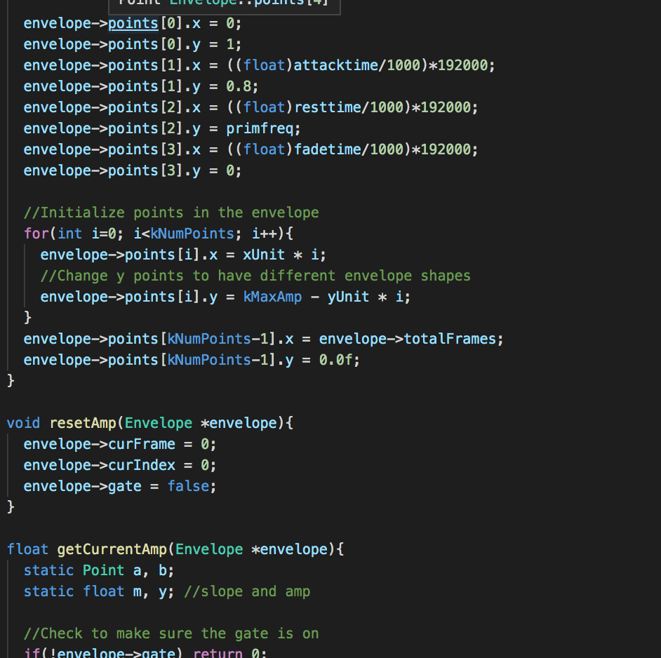
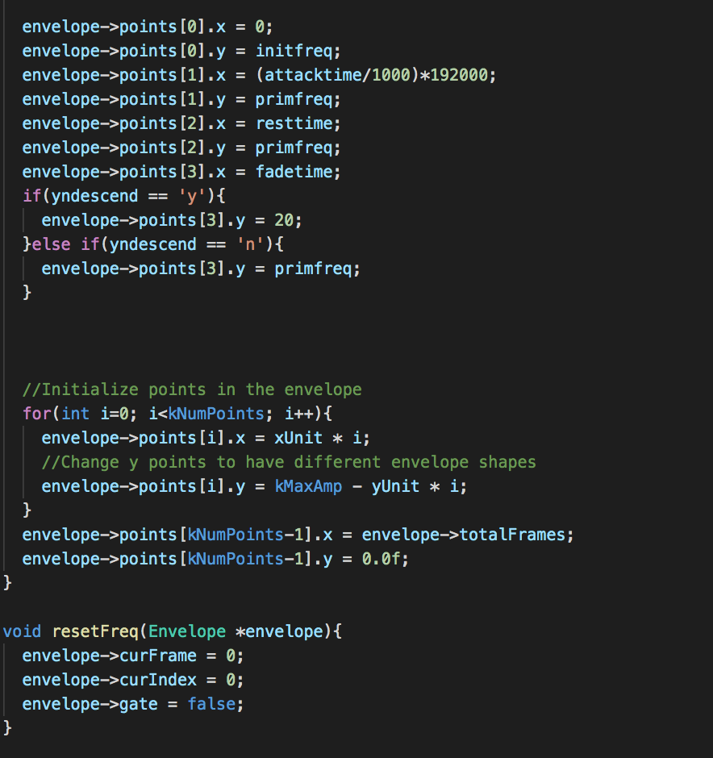
Envelope.h, with PitchEnvelope.c and AmpEnvelope.c

Slide 7
